Slide 1
Ammonia emissions
Zhenqi Luo 2021.3
Notes:
https://doi.org/10.5194/acp-20-2277-2020

Slide 2
progress
1. Difference of NH3 emissions——Adjusted vs GEOS-Chem
2. Regional details of NH3 emissions——fill the in adjusted by GEOS-Chem
Timeseries
Total

Slide 3
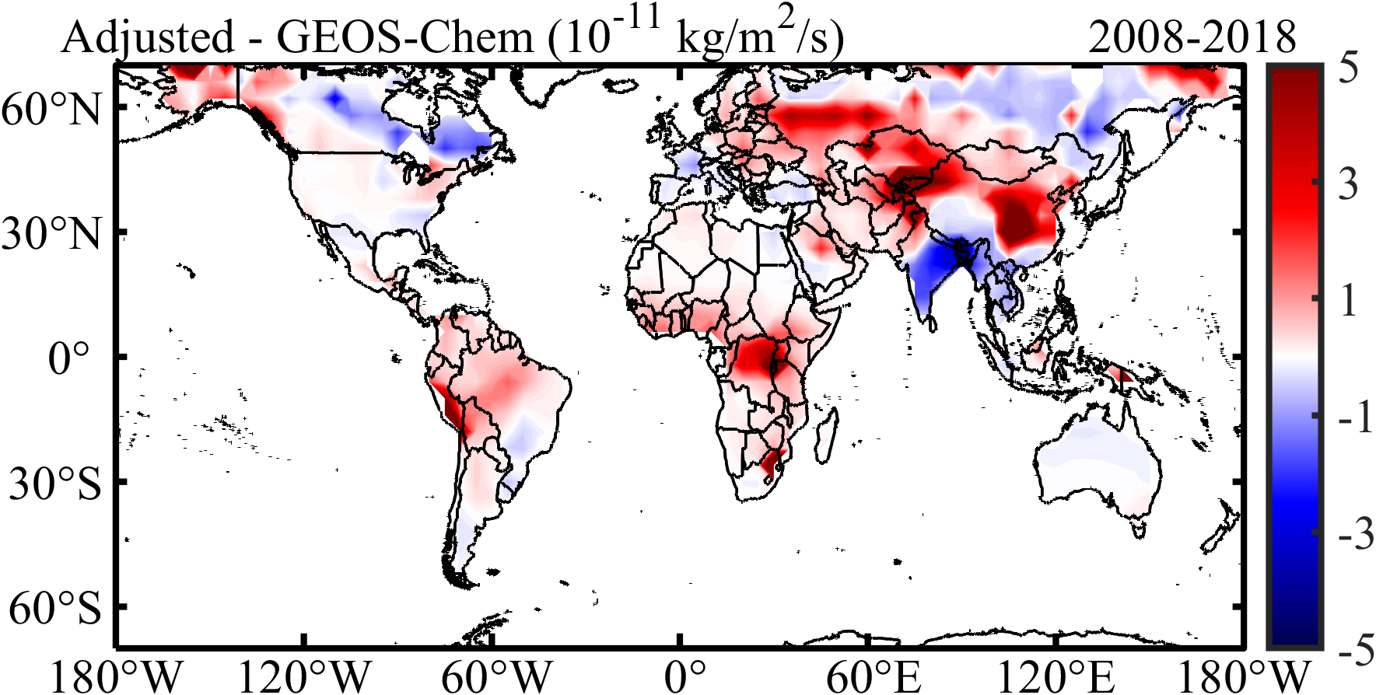
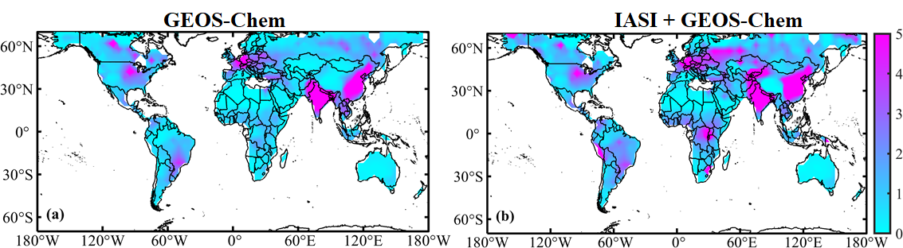
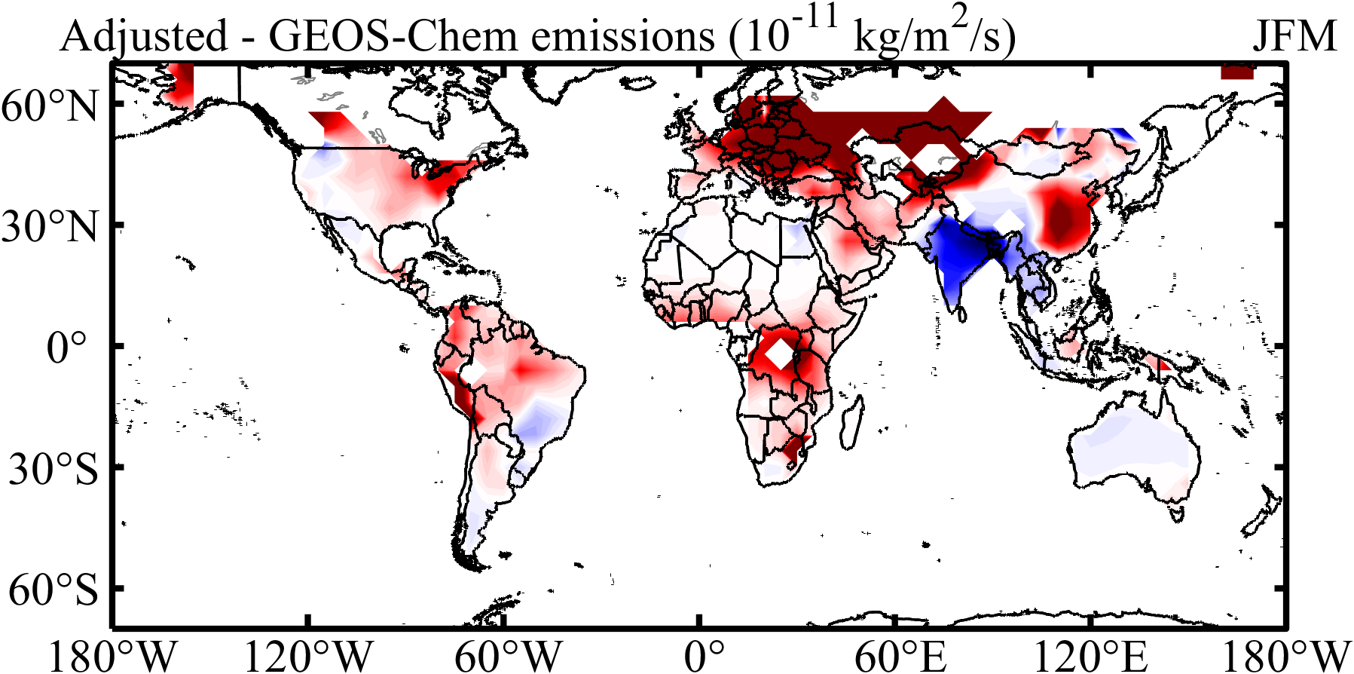
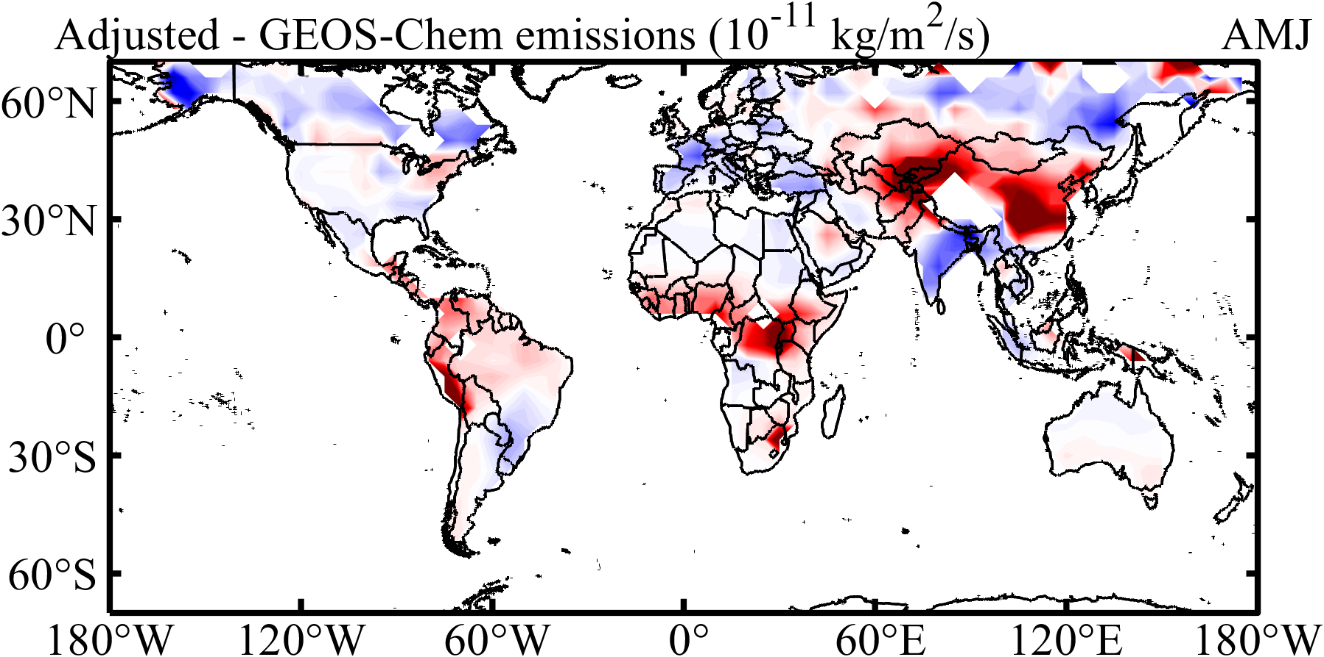
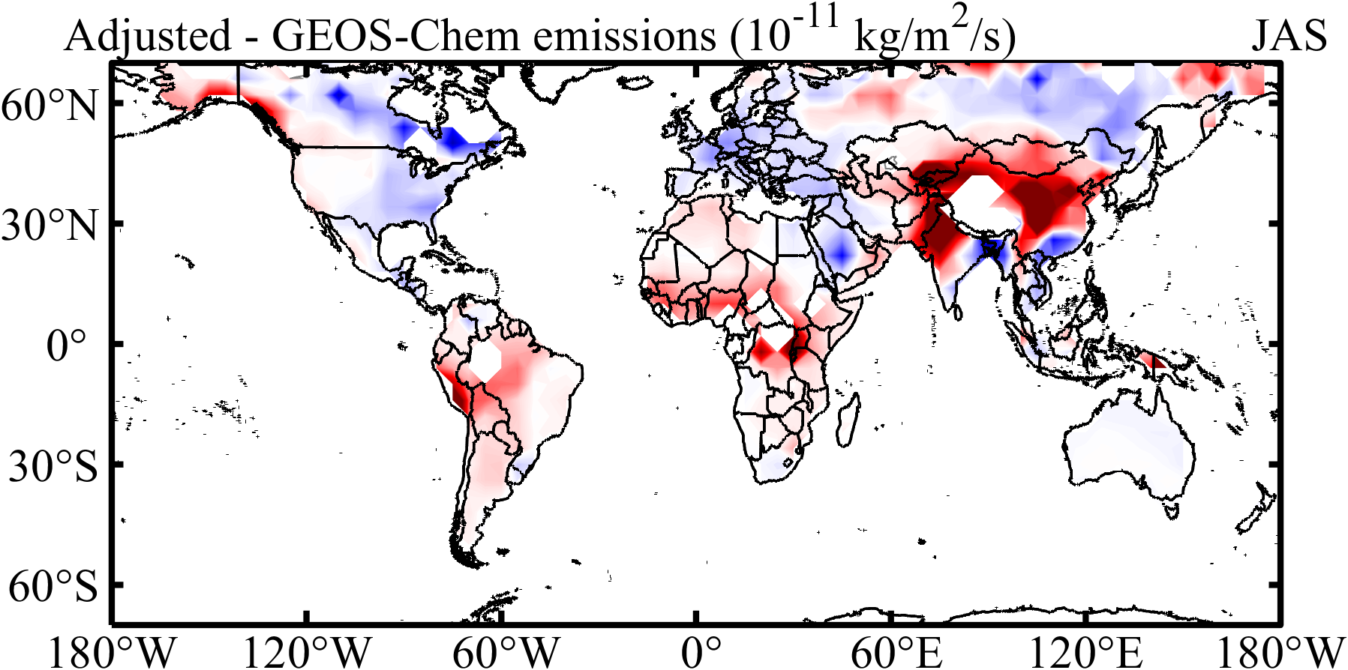
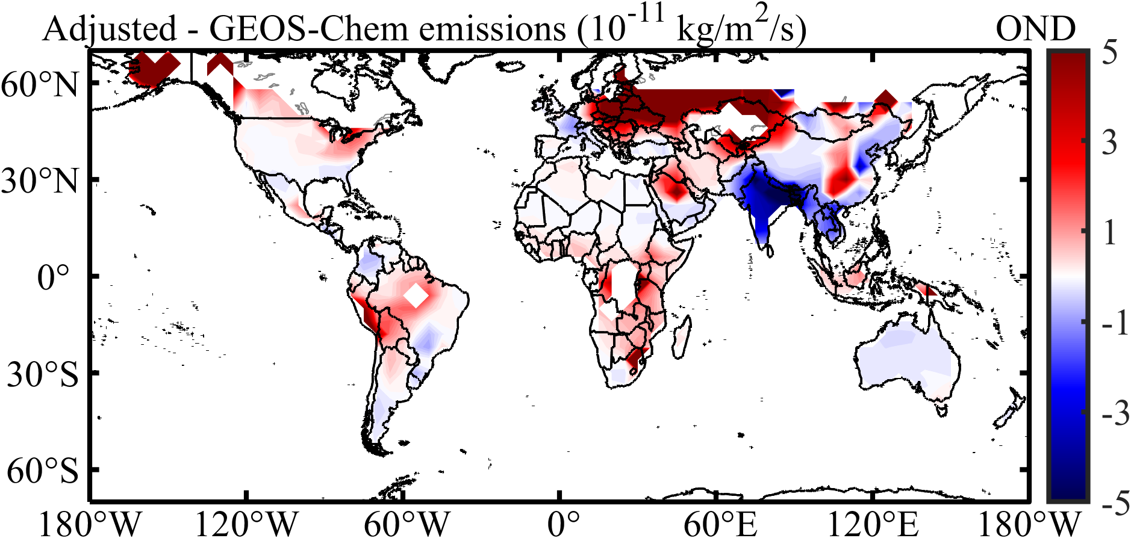
Difference of NH3 emission
EU
US
EC
IP
SA
CA

Slide 4
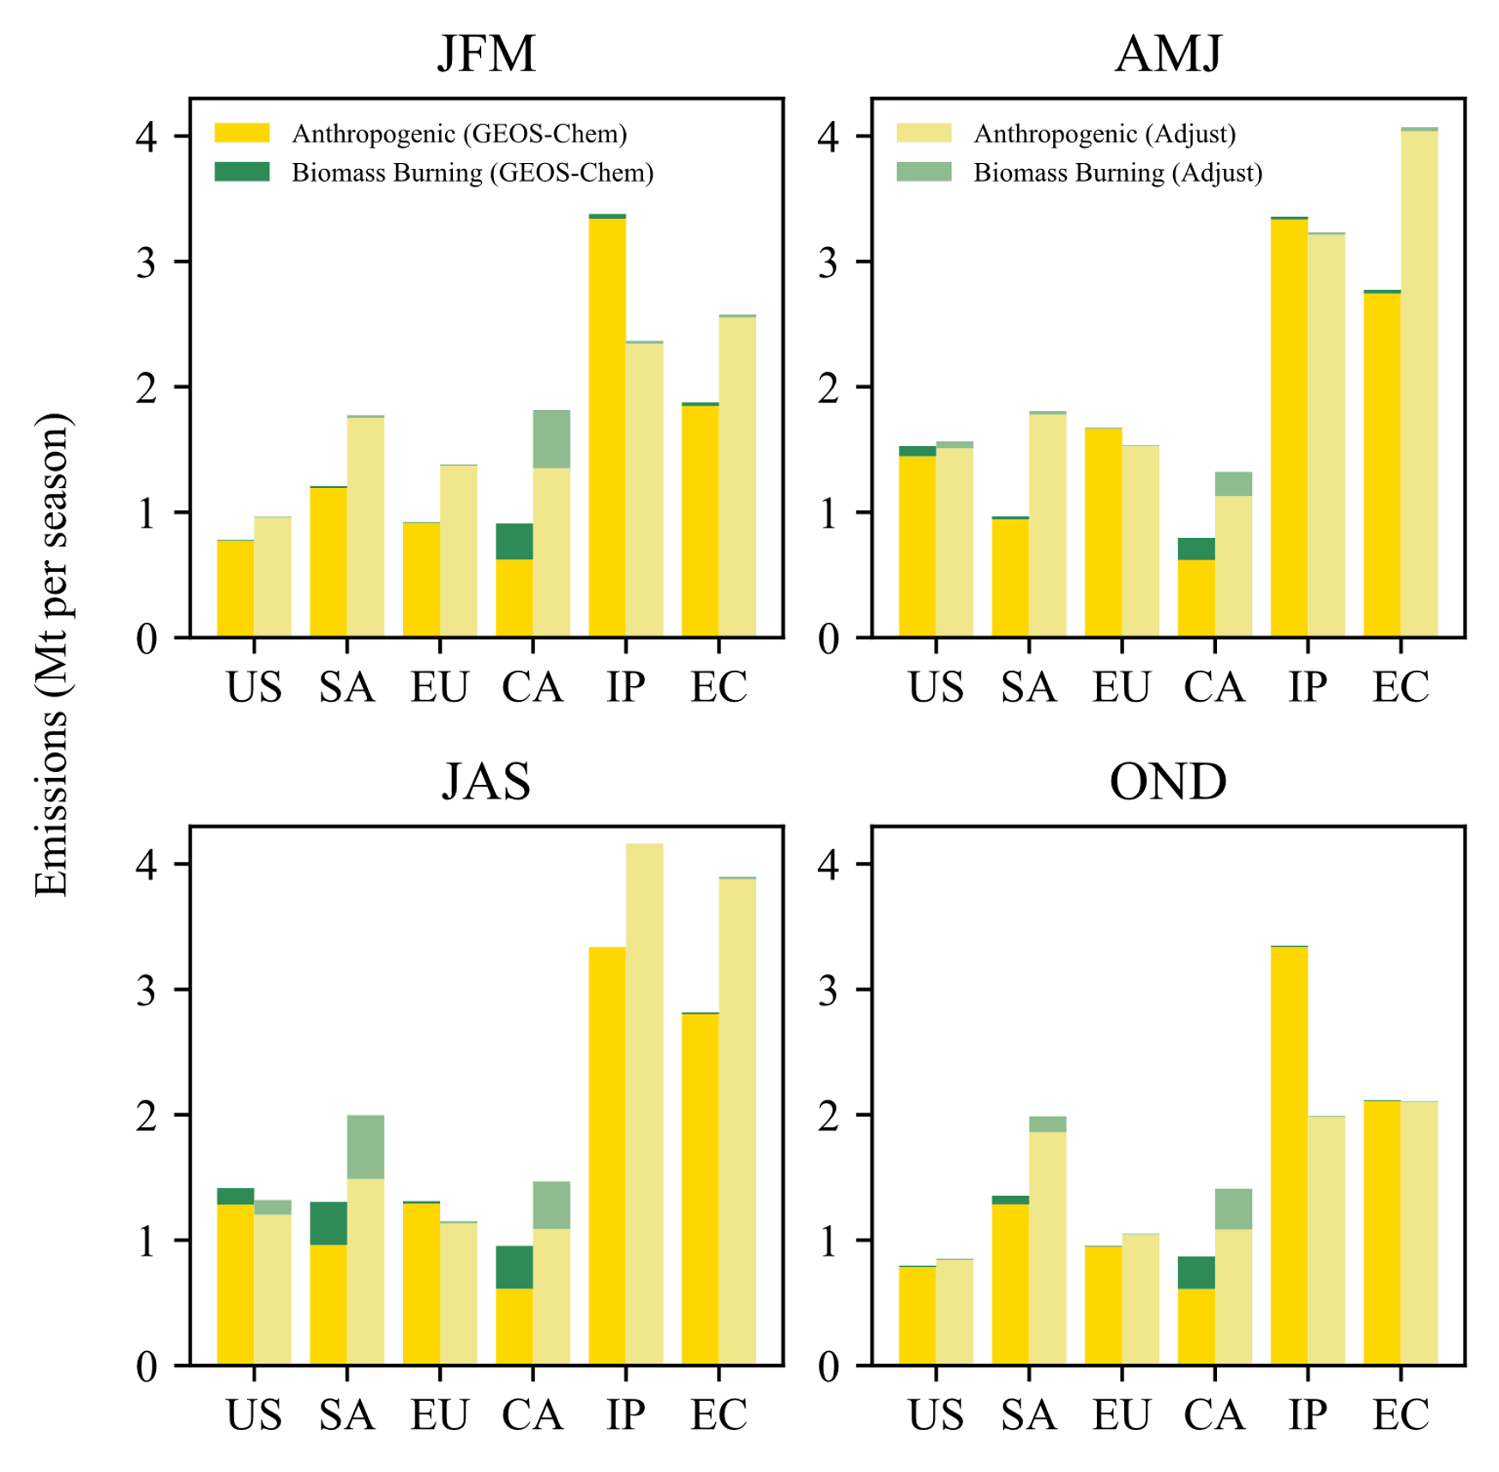
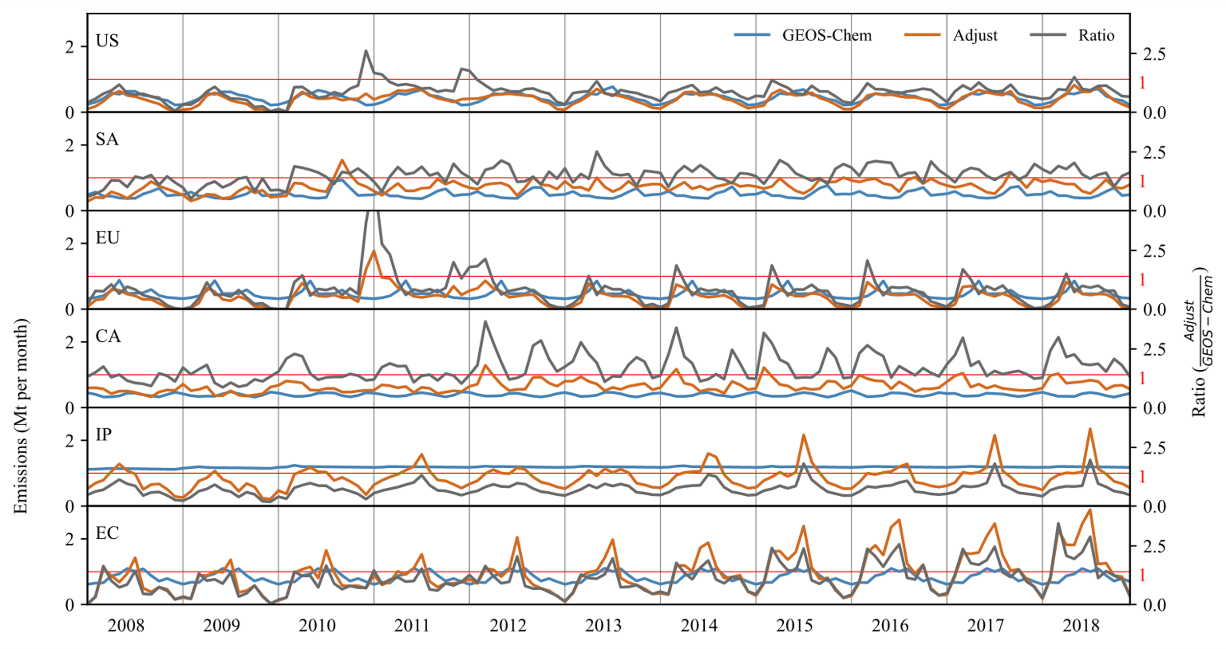
Regional NH3 emission
EU
US
EC
IP
SA
CA

Slide 5
Analysis & Plan
Divide the anthropogenic emissions
Livestock
fertilizer
Check the data quality
Ratio of grid amount
IASI data

Slide 6
litreature

Slide 7
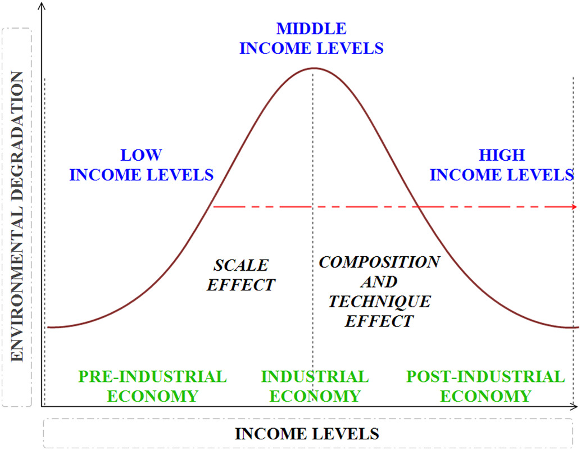
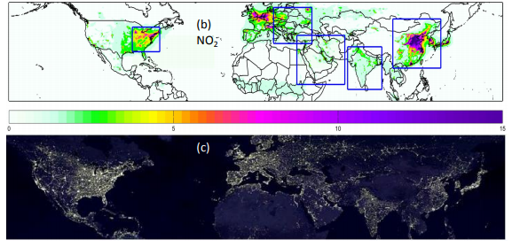
NO2 burden reductions over north equatorial Africa
(Sarkodie et al., 2019)
Socioeconomic development and population growth in low and middle-income countries
Increased environmental degradation——emissions
NO2
Lifetime: < 1 day
total column densities and surface emissions are highly correlated
Toxic
premature mortality
asthma
Sources
fossil fuel combustion
anthropogenic alterations to soils
livestock management
Africa
fossil fuel combustion (increase)
fire-prone savanna ecosystems——70% of the global (decline):
anthropogenic suppression
(Krotkov et al., 2016)
Notes:
https://doi.org/10.1073/pnas.2002579118

Slide 8
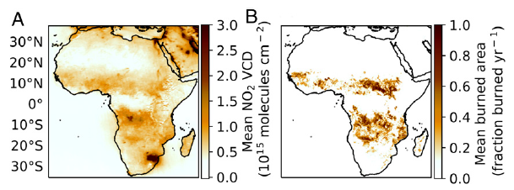
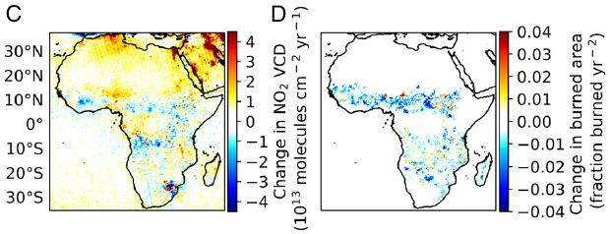
NO2 burden reductions over north equatorial Africa
Data
NO2: OMI
cloud cover < 30%
solar zenith angle < 80
terrain reflectivity < 0.3
free from error flags
include negative
CO: IASI (morning observation)
cloud cover < 10%
NH3: IASI (morning observation)
cloud cover < 25%
Burned area: MODIS
proportion: 1/3
Precipitation: TRMM
Emission:
biomass burning: GFED4s
Fossil fuel: CEDS
Annual burned area and tropospheric NO2
mean: high level
trend: negative
(E. Hickmane et al., 2021)

Slide 9
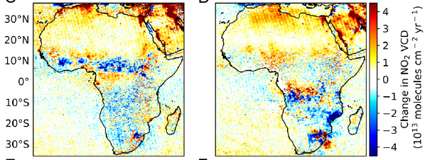
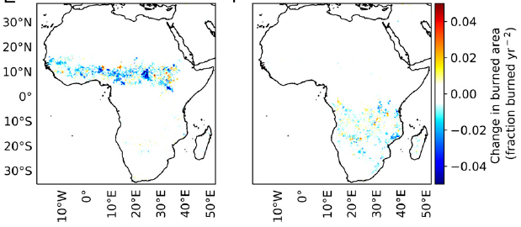
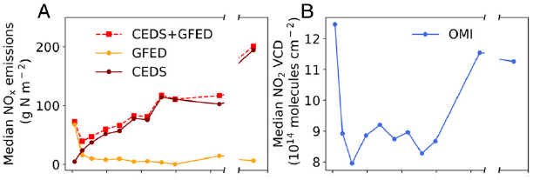
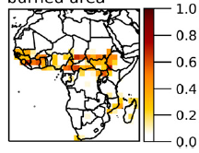
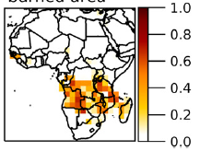
NO2 burden reductions over north equatorial Africa
Nov. to Feb.
Mar. to Aug.
Annual burned area and tropospheric NO2
decline: Nov. to Feb. (biomass burning season)
close spatiotemporal correspondence
GDP density increase:
fossil fuel emissions: increase
biomass burning emissions: decrease
play a more important role——inverted N
(E. Hickmane et al., 2021)
Notes:
the emissions inventories appear to substantially underestimate the mitigating effect of increasing GDP density on NOx emissions during the biomass burning season.

Slide 10
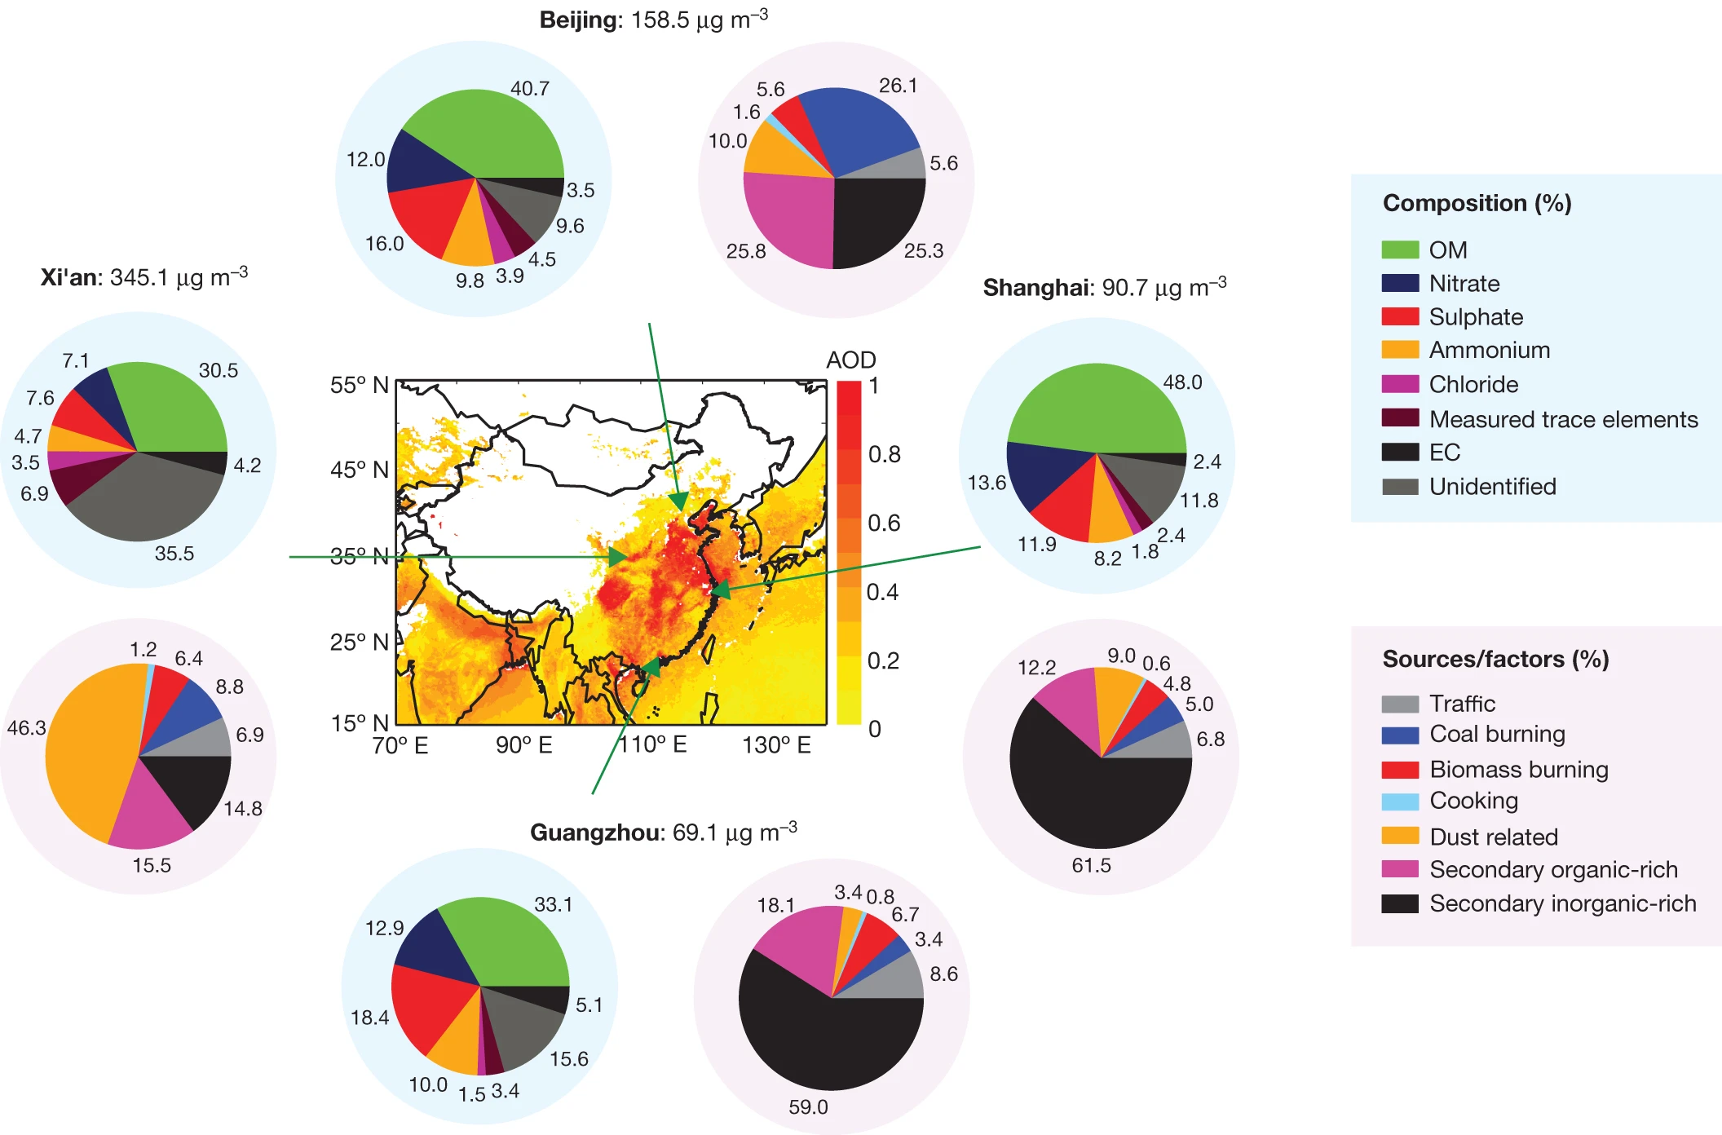
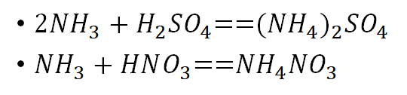
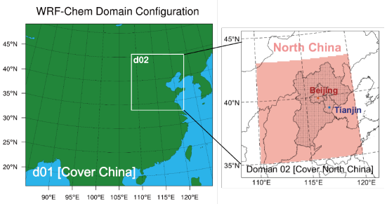
PM2.5 pollution to ammonia emission reductions in North China
the North China Plain
severe PM2.5 air pollution
emission control measures——fuel combustion
SO2
NOx (NO + NO2)
primary aerosols
Secondary inorganic aerosols
Model simulations
base: the 2015 emission conditions
S1RN (N = 20/40/60/100): reduce NH3 emissions
S2RN (N = 20/40/60/100): reduce NOX by 8% and SO2 by 40%
S3RN (N = 20/40/60/100): further reduce NOX by 20%
(Huang et al., 2014)
(Liu et al., 2021)
Notes:
https://doi.org/10.1088/1748-9326/abdf86

Slide 11
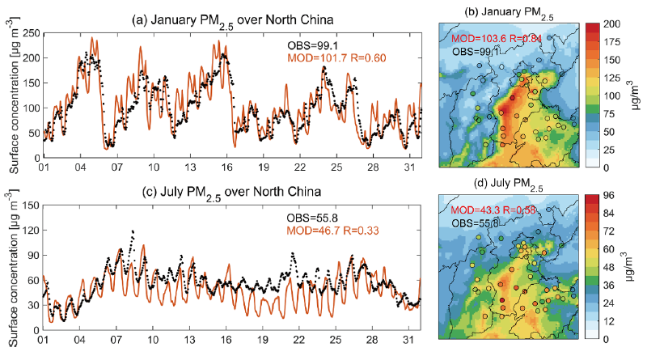
PM2.5 pollution to ammonia emission reductions in North China
The WRF-Chem model——WRF+Chemistry
mechanism: the gas-phase Carbon-Bond Mechanism Z
physical settings: Morrison double-moment microphysics scheme et al.
emissions:
anthropogenic: MEIC, agricultural NH3 from updated statistics for the year 2015
biogenic: Model of Emissions of Gases and Aerosols from Nature
biomass burning: Fire Inventory from the NCAR
Meteorology:
10 m wind direction
10 m wind speed
2 m air temperature
2 m relative humidity
Surface measurements
surface PM2.5
NH3 concentrations: Ammonia Monitoring Network in China
Observed and simulated surface pollutant concentrations
PM2.5: in good agreement
(Liu et al., 2021)
Notes:
https://doi.org/10.1088/1748-9326/abdf86

Slide 12
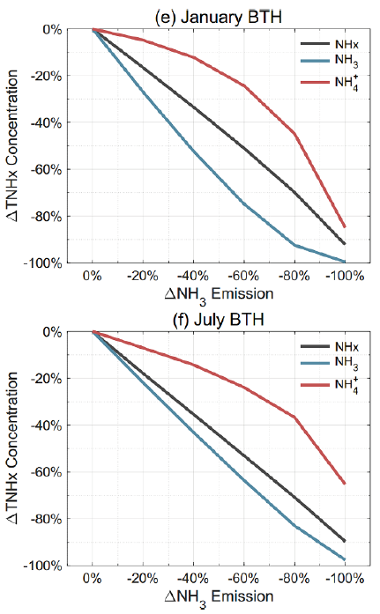
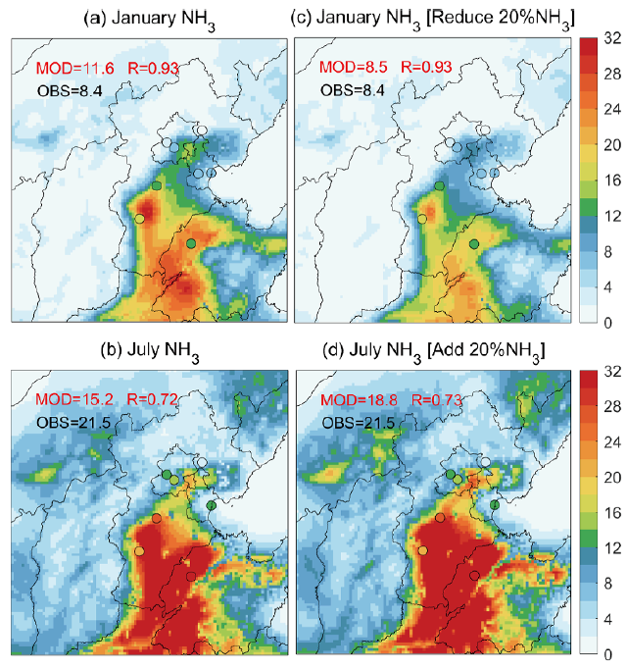
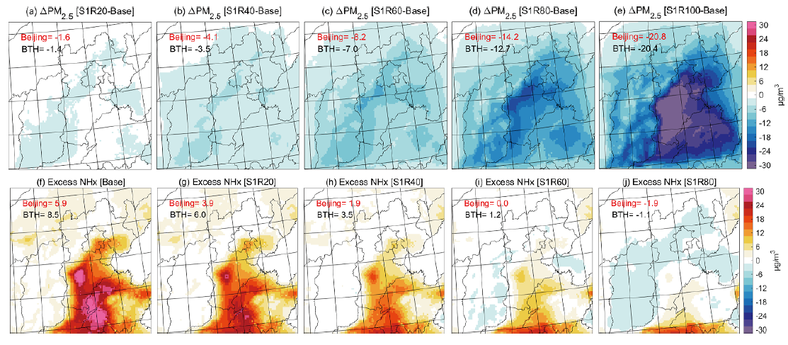
PM2.5 pollution to ammonia emission reductions in North China
Observed and simulated surface pollutant concentrations
NH3 concentrations: biased high by 30%+
decrease/increase anthropogenic NH3 emissions by 20%
the effect of NH3 emission changes on surface concentrations: NHx = NH3 + NH4+
Response of PM2.5 pollution to NH3 emission reductions
changes in surface PM2.5:
more distinct with stronger NH3 emission reductions
highly saturated in the southern Hebei province
(Liu et al., 2021)
Notes:
https://doi.org/10.1088/1748-9326/abdf86

Slide 13
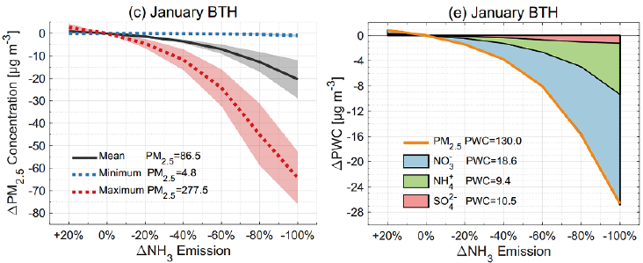
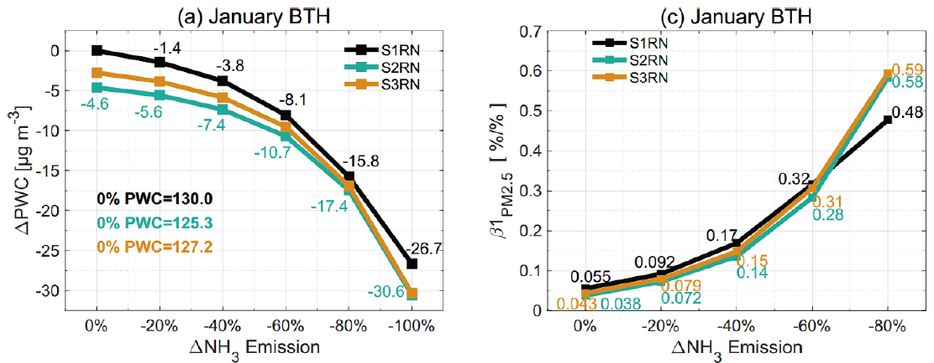
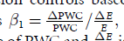
PM2.5 pollution to ammonia emission reductions in North China
Response of PM2.5 pollution to NH3 emission reductions
changes in surface PM2.5:
a power exponential function
Effects of NOx and SO2 emission changes
the changes in BTH PWC
the changes in BTH β1 efficiency
high NH3 emission: decrease
low NH3 emission: increase
(Liu et al., 2021)
Notes:
https://doi.org/10.1088/1748-9326/abdf86
population-weighted PM2.5 concentration (PWC)

Slide 14
Questions?

